Slide 1

Graph Convolutional Networks for Coronary Artery Segmentation Using Filtered Annotations
11/17/2021
Intern: Shiqi Liao
Supervisor: Mark Punt, Ron Schormans
Supervise professor: Anna Vilanova

Slide 2
Contents
Background
Problem description
Methodology
Experiment
Result
Challenge and temporary solution
Conclusion

Slide 3
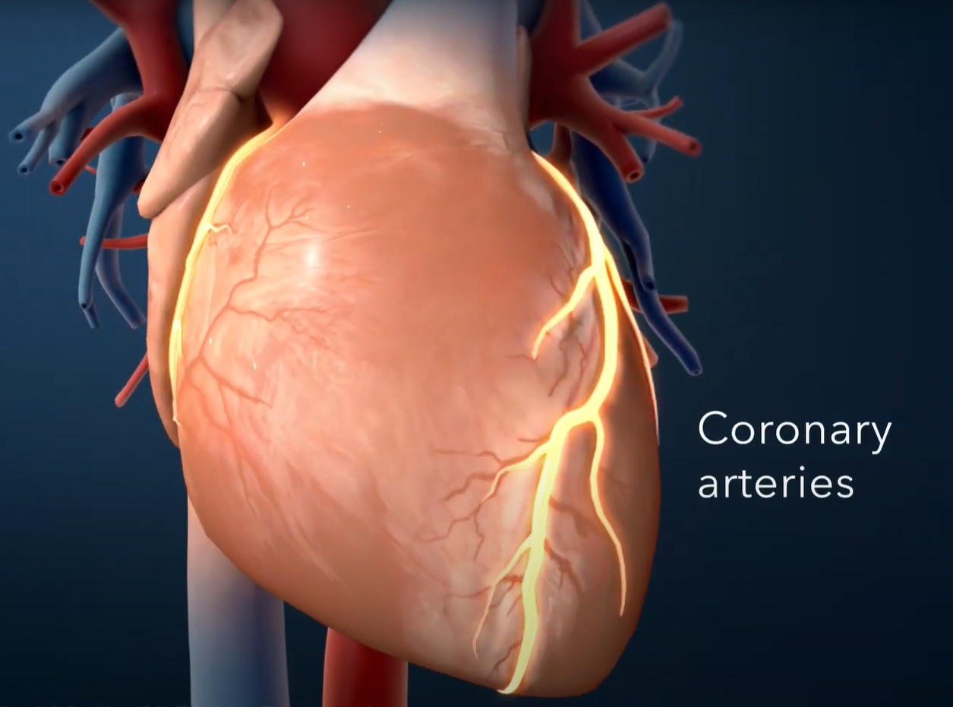
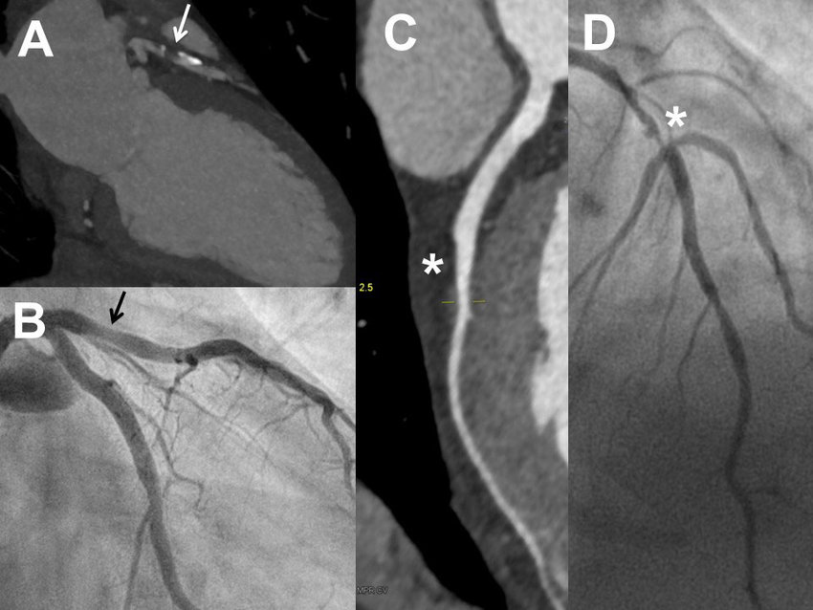
Background
Coronary artery stenosis detection and blood flow simulation rely on analysis of anatomical or functional severity information provided by Coronary CT angiography (CCTA) images.

Slide 4
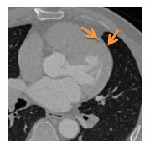
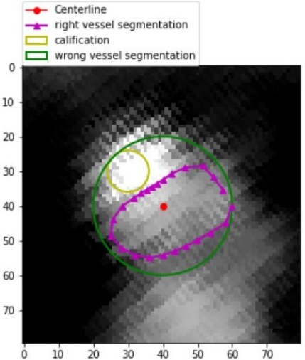
Background
Automated processing of CCTA images is difficult to implement because there are no obvious rule-based patterns to generate coronary lumen surface meshes (a.k.a. segmentation) with enough sub-voxel accuracy.

Slide 5

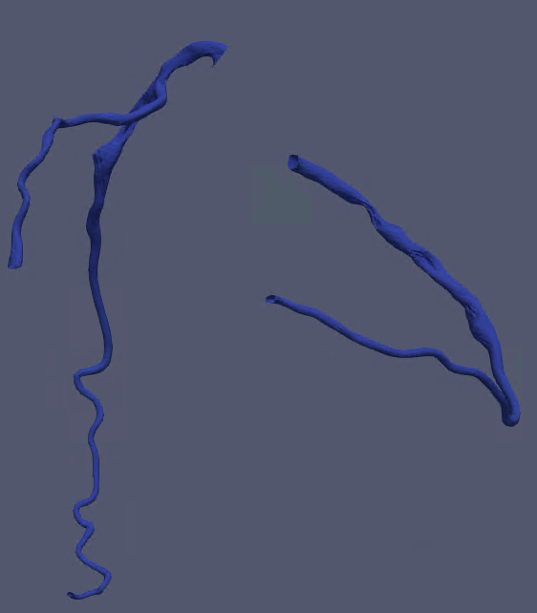
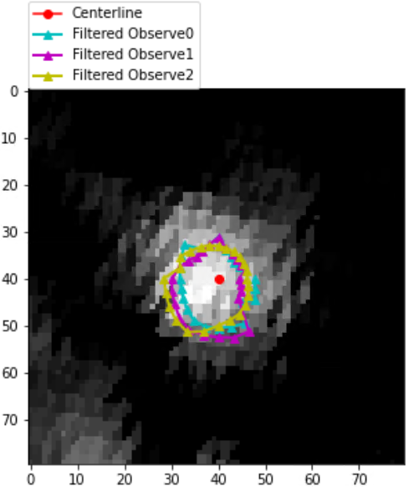
Problem description
CCTA images of 18 patients
78 vessel segments
Extracted centreline
Corresponding Normals
3 annotations per one

Slide 6
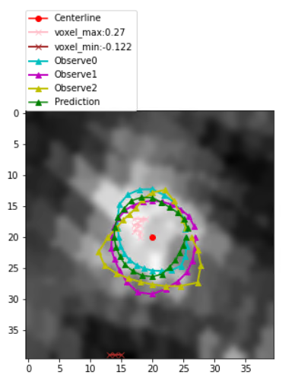
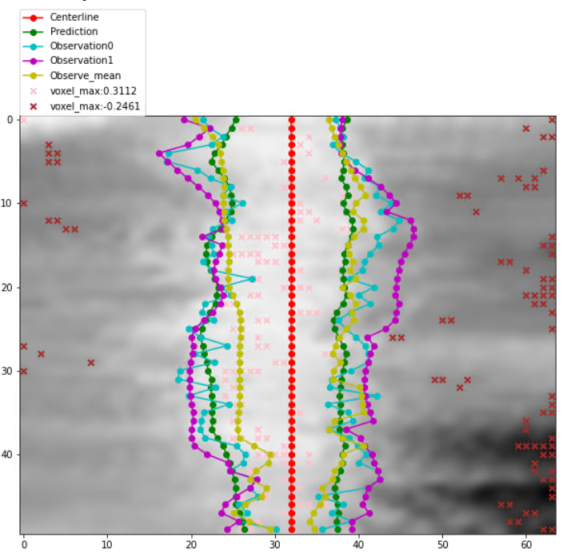
Problem description
To predict a lumen for each CCTA image slice at a center point.
To guarantee the roundness of a lumen and the smoothness between lumens.
To unify the annotations from three experts.

Slide 7
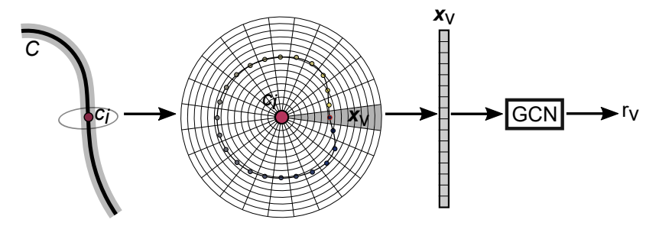
Methodology
Construct a polygonal lumen surface mesh
Given a centre point and normal vector, we could determine a cross-sectional plane.
Define a cross-section of the surface mesh by 24 equiangularly spaced vertices(rays).
Location of each vertex is defined in polar coordinates (φv, rv).
Features are defined as 32 voxels along the ray of length 3.2mm(resolution 0.1 mm)

Slide 8
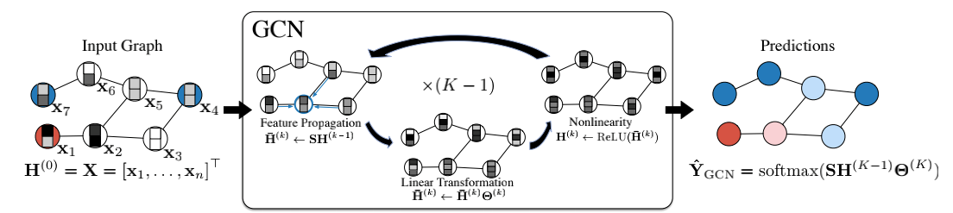
Methodology
GCN model
Define each row as a node and present their relationship by an edge.
Model training with feature propagation along edges.

Slide 9
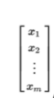
Methodology
GCN model-feature propagation
First aggregation
Other 4 aggregations

Slide 10
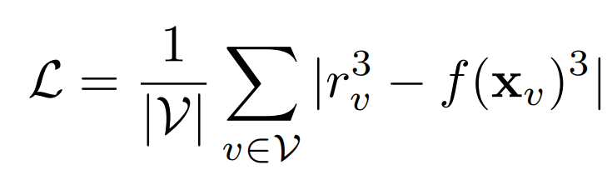
Training
Experiment
Evaluation
Use 3 annotations as true labels
LOOCV(Leave one patient out cross validation)
Hyper-parameter selection: dropout, epoch, learning rate
For each training, compute loss with a random segment
Accumulate training losses per 10 trainings to backpropagate
Loss function:
Use average annotations as true labels
Evaluate healthy and diseased vessels separately
Evaluation Matrix: DSC, MSD, HD (explain later)
Compute average evaluation matrix from 18 folds of LOOCV

Slide 11
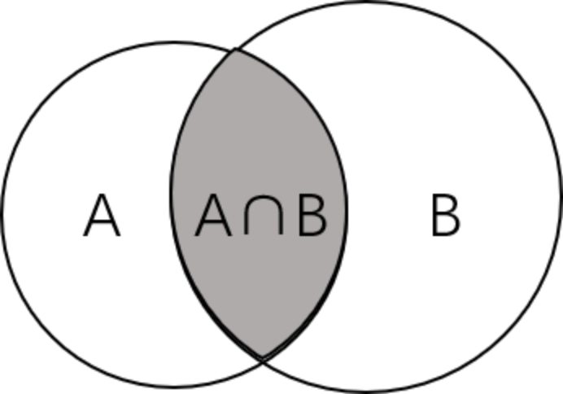
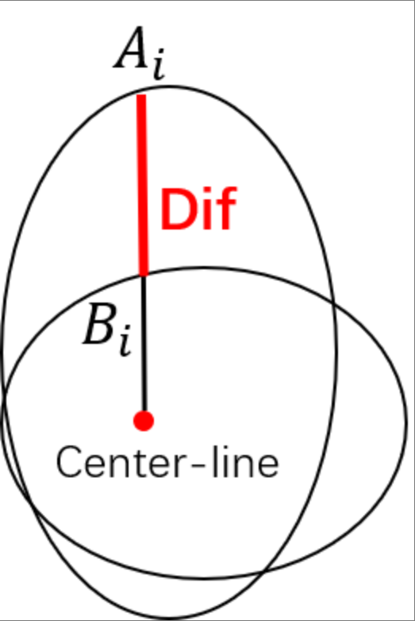
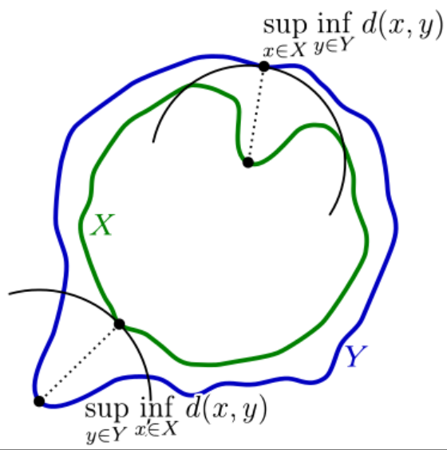
Experiment
DSC
MSD
HD

Slide 12
Result
Hyper-parameter | Dropout | Epoch | Learning rate
Value | 0.1 | 5000 | 0.001
 | HEALTHY VESSELS |  |  | DISEASED VESSELS
Evaluation-matrix | DSC | MSD | HD | DSC | MSD | HD
PIE GCN | 0.80 | 0.04 | 0.64 | 0.82 | 0.18 | 0.92
Paper GCN | 0.75 | 0.25 | 1.53 | 0.73 | 0.28 | 1.86

Slide 13
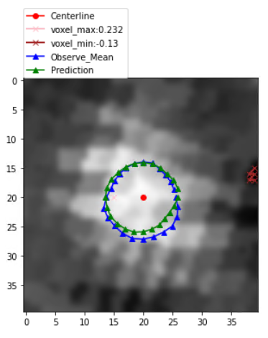
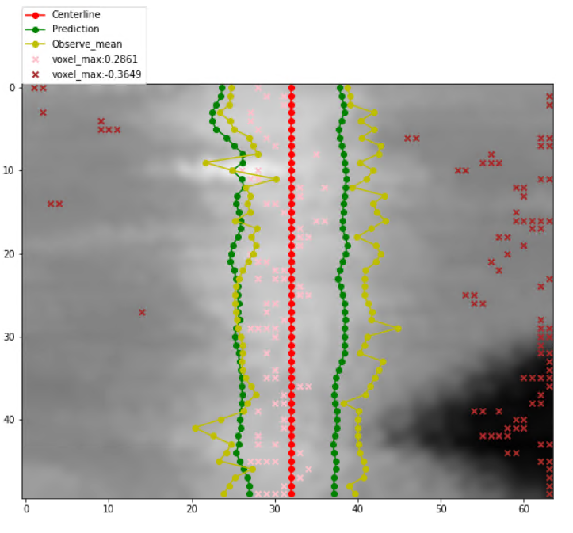
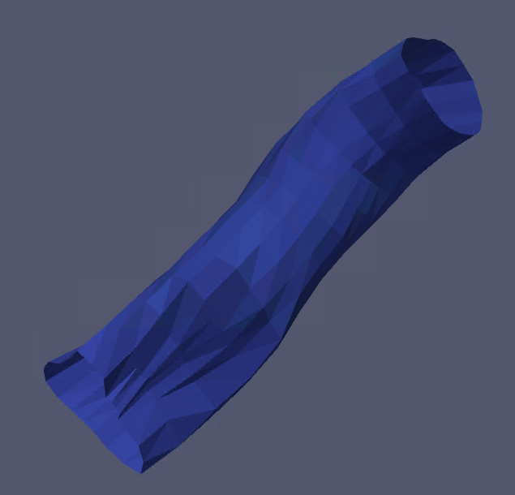
Result
Slice image
Side image
Triangulation image

Slide 14
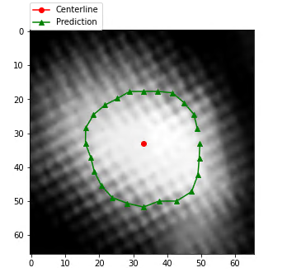
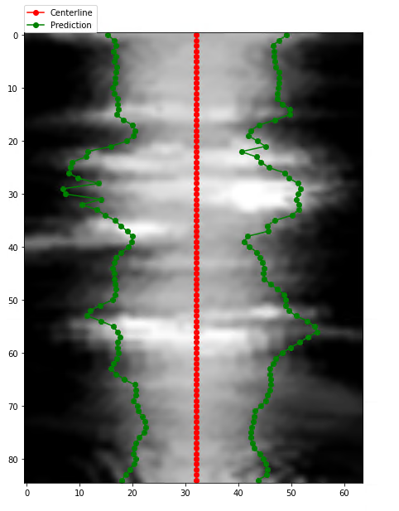
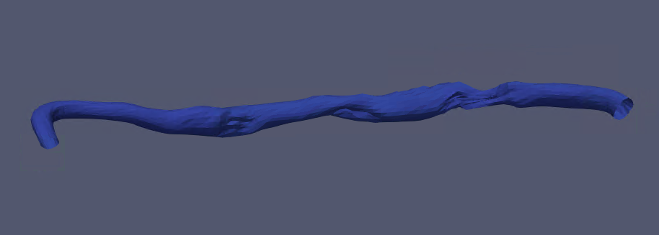
Result – on real RCA data
Slice image
Side image
Triangulation image

Slide 15
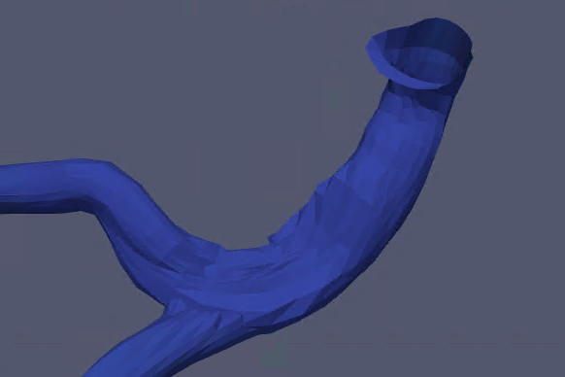
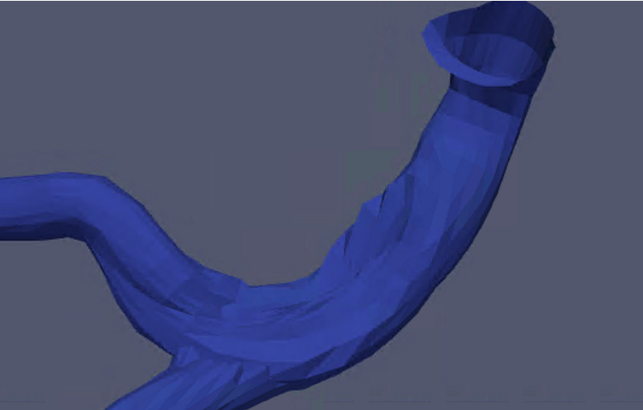
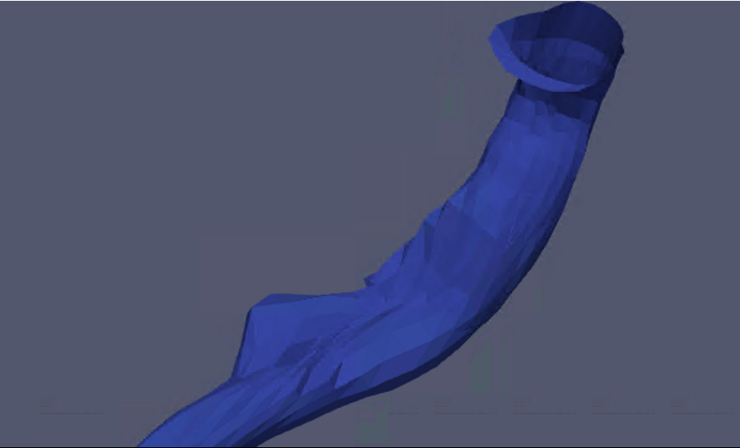
Result – on branching part
LAD + LCX +LM
LCX + LAD
LAD
LCX
LM
LAD

Slide 16
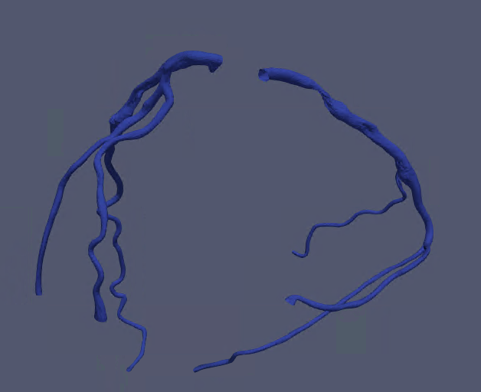
Result – on whole real data

Slide 17
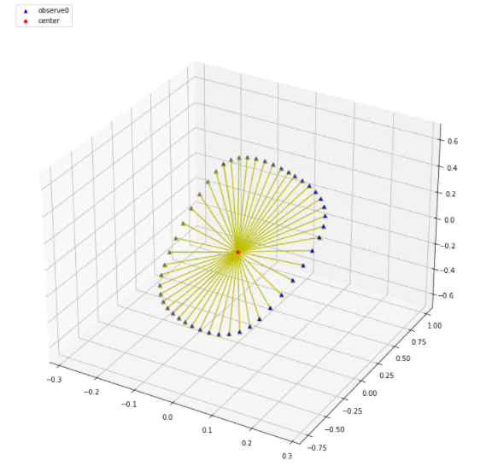
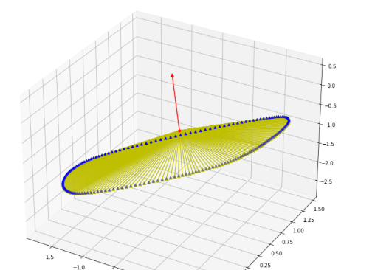
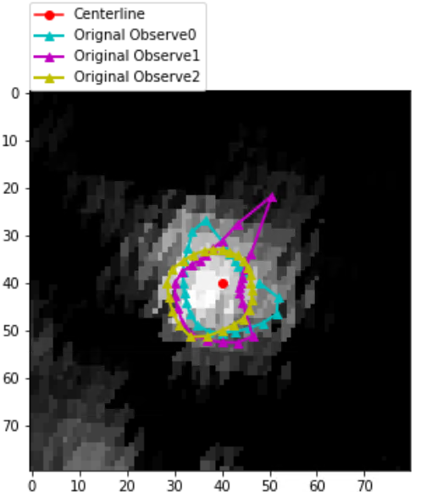
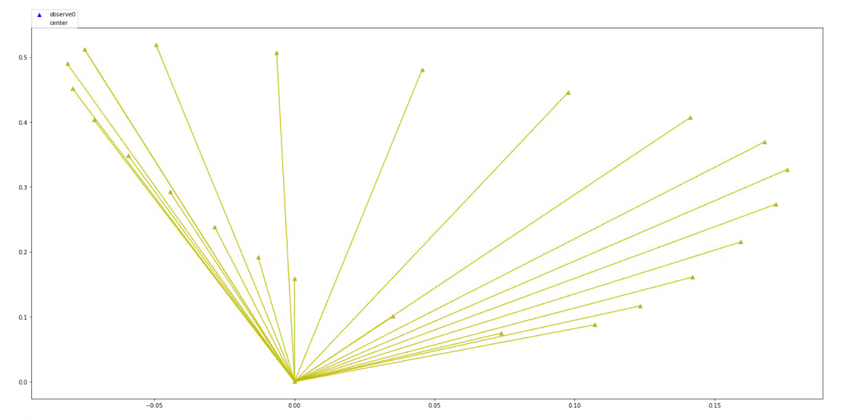
Challenge and temporary solution
A centre point is not within the slice plane
Annotated lumen does not include centre point
Annotations from three experts dose not agree

Slide 18
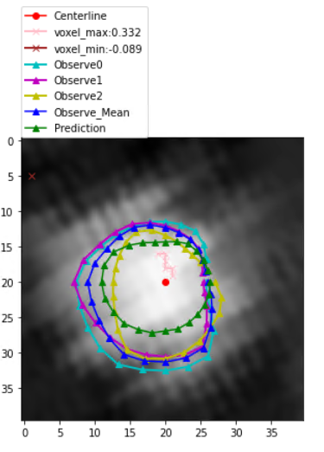
Conclusion
GCN has a good performance on CCTA vessel segmentation on accuracy, smoothness.
GCN can handle the vessel segmentation at branching.
GCN is easy to predict smaller than real lumen as a result of limited training data

